Slide 1


National Technological University General Pacheco Regional Faculty
Subjet: English
Student: Miguel Angel Lardo
Date: November 15, 2024
Notes:
5-Currently, BIG GYM provides a professional fitness experience” ikˈspirēəns” with dedicated “deriqueired” areas for free weights “buits” and machines (such as barbells, dumbbells, and kettlebells), group classes for CrossFit and yoga, and personalized “personalais” training sessions “seshons” for fitness and bodybuilding.
6-Also, BIG GYM offer sports supplements, like protein shakes.
“saplements”

Slide 2
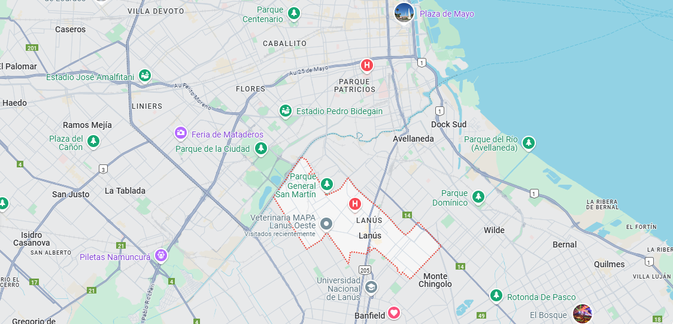



BIG GYM
Fitness and Wellness
2020
Notes:
1-BIG GYM is an Argentinian fitness and wellness company headquartered in Lanús, Buenos Aires.
“hedcuartert”
2-It was founded on January 2020 by Miguel Angel Lardo. - > faunded ja·nyoo·uh·ree
3-the gym operates (ópereits) independently ( indepéndent ly) and does not have subsidiaries (sab síRi eris)

Slide 3
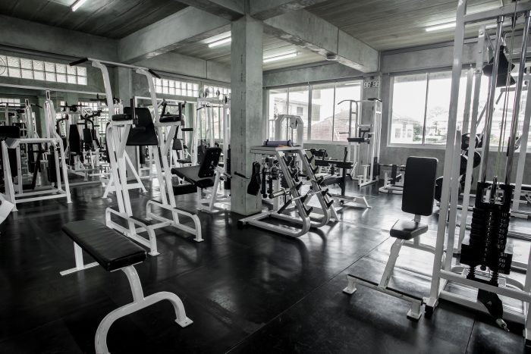
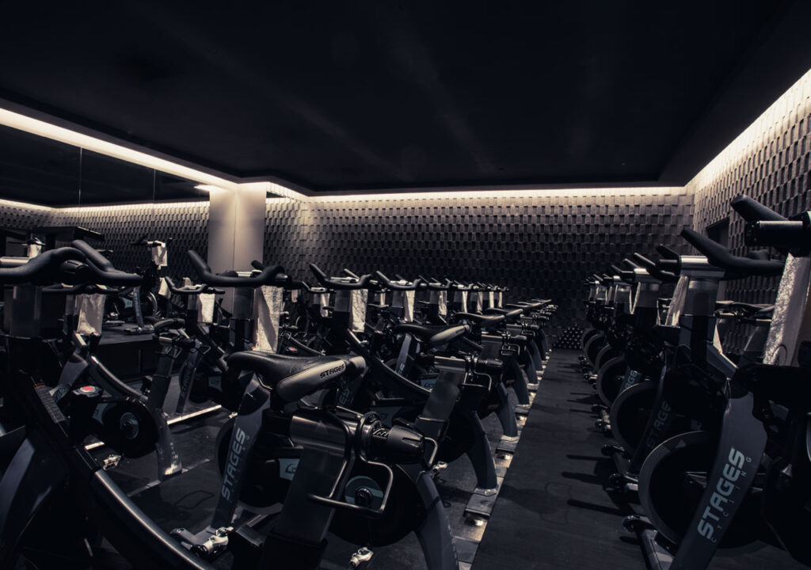

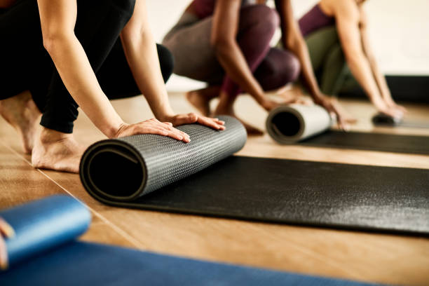
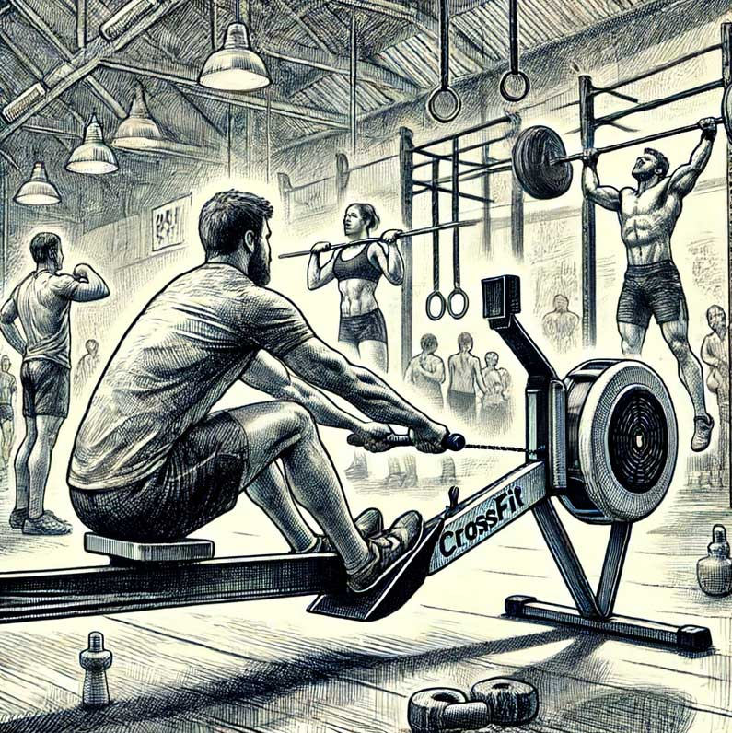
BIG GYM
Beginnings
Expansion
Notes:
4-In the beginning, the gym started as a place for powerlifting. Then, it expanded its servicies to include fitness, spinning, yoga, and CrossFit.
“Inishialy” “stared” “er ikˈspandəd” “servicis”

Slide 4
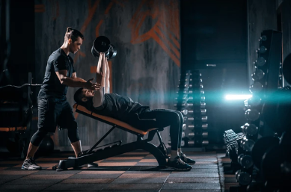

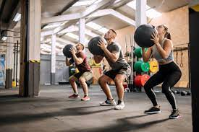
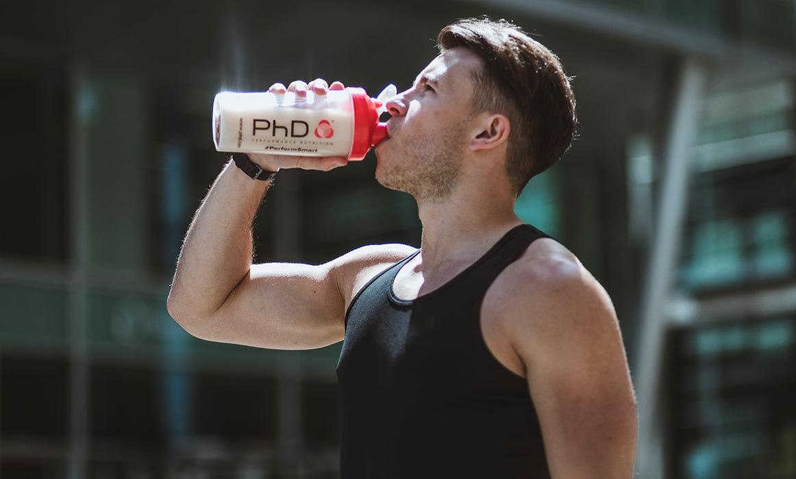
BIG GYM
Currently
Free Weights Lifting
Machines
Group Activitis
Personalized training sessions
Notes:
5-Currently, BIG GYM provides a professional fitness experience” ikˈspirēəns” with dedicated (derikeiRed) areas (erias) for free weights “buits” and machines (such as barbells, dumbbells, and (kéRUHl bels), group activities (actíviRis) like CrossFit and yoga, and personalized “personalais” training sessions “seshons” for fitness and body building (baRy bilding)
6-The GYM also offer (áfers) sports supplements, like protein shakes. (próutin sheiks)
“saplements”

